Slide 1




Bus Rapid Transit (BRT)
Team members:
Amal Al-Da’abseh Dunia Alewaidat
Supervisor:
Dr. Omar Al-Marayat

Slide 2

Scenario:
Jordan Rapid Bus System aims to improve public transportation by adding and optimizing bus movements across the city. The system faces challenges in managing the addition of new buses to different routes based on actual demand. Additionally, there are delays in updating users when there are changes in bus status, such as delays or route modifications. The system also needs to support undoing user-issued actions and simplify control over different subsystems through a unified interface.

Slide 3
Jordan Rapid Bus System Components
Bus Factory
Responsible for dynamically creating new buses when needed to handle increased demand on a route.
Observer Manager
Handles updating bus stops, user apps, and notifications in real-time when the bus status changes (e.g., delays, arrivals).
Command Handler
Encapsulates user commands such as requesting a bus or changing the route, with support for undo operations.
Facade Controller
Simplifies control over multiple subsystems like bus scheduling, ticketing, and route management through a single unified interface

Slide 4

Dynamic Creation & Control of Buses (Problem 1)
Scenario:
The Jordan Rapid Bus System needs to dynamically add new buses to routes based on actual demand. The system requires a way to create a new bus object whenever a route experiences congestion or increased passenger load.
Solution – Factory Method Pattern (Creational Design Pattern):
A BusFactory class provides a createBus() method.
This method returns a new Bus instance with a unique bus number.
This decouples bus creation from route management code and allows the system to dynamically add buses whenever needed.

Slide 5
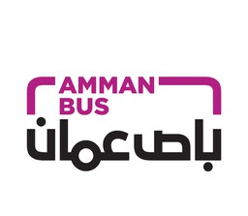
Use Case Scenario – Dynamic Creation & Control of Buses
Use Case Name: Create and Add New Bus
Actors: System, BusLine Main Flow:
System detects congestion or high passenger demand on a specific route. System calls BusFactory.createBus().
Factory returns a new Bus instance with a unique bus number.
System adds the new bus to the corresponding BusLine using BusLine.addBus(newBus). Postcondition: A new bus is dynamically created and added to the route to handle increased demand.

Slide 6
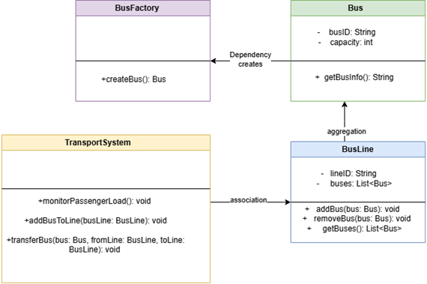

Slide 7
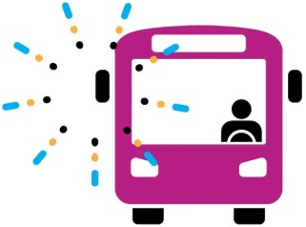
Test Case:
Test Case ID: TC-1 Description:
Verify that a new Bus can be created dynamically and added to a BusLine, and an existing Bus can be transferred from another line to the target line.
Preconditions:
At least one BusLine exists with a Bus. TransportSystem is running.
BusFactory is available. Steps:
Call BusFactory.createBus() to create a new Bus.
Call TransportSystem.addBusToLine(busLine) to add the new Bus. Select an existing Bus from another line.
Call TransportSystem.transferBus(bus, fromLine, toLine) to move it. Check all BusLine lists to verify correctness.
Expected Result:
The new Bus is created successfully and added to the target line.

Slide 8

UI Updates on Bus Status (Problem2)
Scenario:
When the bus status changes (e.g., delay, arriving at a station), all connected components (station screens, passenger notifications) must update in real-time.
Solution – Observer Pattern (Behavioral Design Pattern) Subject: Bus manages its status and the list of observers.
Observers: StationScreens, PassengerNotifier, MobileApp update on status changes.

Slide 9

Use Case Scenario:
Use Case Name: Reflect Bus Status Change on UI
Actors: Passenger, Bus Tracking System Main Flow:
Bus status changes (e.g., "Arrived at Station A"). Bus notifies all observers.
Station screens update, notifications are sent to passengers, app UI reflects new status.
Postcondition: Passengers and station displays always show the latest bus status.

Slide 10
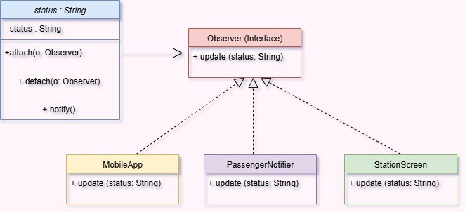

Slide 11
Test Case:
Test Case ID: TC-OBS-01
Scenario: Verify observers update when bus status changes. Steps:
Change bus status to "Delayed".
Trigger notify() from Bus.
Check updates on StationScreen, PassengerNotifier, MobileApp.
Expected Result: All observers immediately reflect "Delayed" status.

Slide 12

Encapsulating Bus Operations with Undo Support (Problem 3)
Scenario:
Admins can send multiple commands to the system, such as “Add a bus to the line” or “Change route.” Sometimes, the passenger needs to undo these commands (e.g., canceling a bus request).
The system supports storing commands with the ability to undo them using the Command Pattern.

Slide 13
Use Case Scenario
Use Case Name: Execute and Undo Bus Commands
Actors: Admins , BRT Application Main Flow:
The Admins requests to add a new bus to the line (sending AddBusCommand). The Admins requests to change a bus route (sending ChangeRouteCommand). The Admins clicks the “Undo” button.
The last command (Change Route) is undone, and the bus returns to its previous route.
Postcondition: Commands are executed successfully and can be undone when needed.

Slide 14
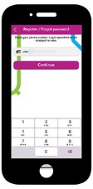
Test Case:
Test Case Name: Undo Change Route Command
Precondition: A bus is currently operating on Route 5. Steps:
The Admins sends a ChangeRouteCommand to change the bus route from Route 5 to Route 7. The system executes the command and switches the bus to Route 7.
The Admins clicks the “Undo” button.
The system retrieves the last executed command (ChangeRouteCommand) and calls undo().
Expected Result:
The bus returns to its previous route (Route 5).
A notification is displayed to the passenger confirming that the undo operation was successful

Slide 15
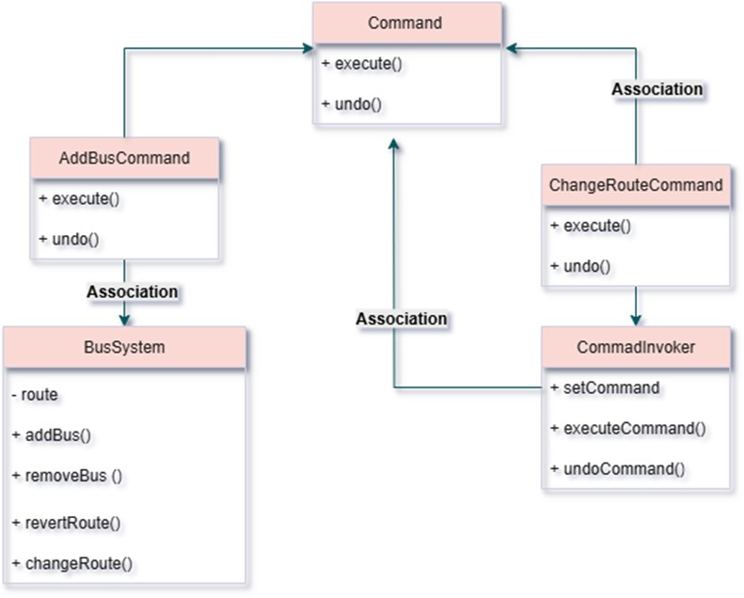

Slide 16
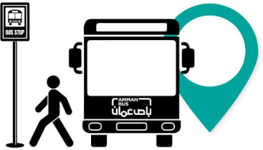
Simplify Complex Subsystem Access for Fast Bus Control (Problem 4)
Scenario:
The user wants to activate "Fast Bus Mode" upon arriving at the station, which will turn on the lights, set the bus to its fastest speed, disable alarms, and start notifying users about the status of the bus. Instead of controlling each system individually, they need a single button to do all of this with ease.

Slide 17
Solution using Facade Pattern (Structural Design Pattern):
A Facade named FastBusModeFacade provides the activateFastBusMode() function to execute all commands at once.
It adds the activateAwayMode() function to activate Away Mode (turn off all systems and activate alarms).
It also adds the activateNightMode() function to set the bus to a sleep mode (low speed, outdoor protection).
Use Case Scenario:
  Use Case Name: Activate Fast Bus Mode
  Actors: User, FastBusModeFacade (as a technical actor representing the intermediate system)
  Main Flow:
The user presses the "Fast Bus Mode" button in the app.
The app calls the activateFastBusMode() function from FastBusModeFacade.
The system turns on the lights, sets the bus to its fastest speed, disables the alarm, and starts notifying users about the bus status.
Postcondition: The bus is ready to travel with all systems in fast mode.
This is the adjusted scenario for problem 4, focusing on the fast bus system without any extra additions.

Slide 18
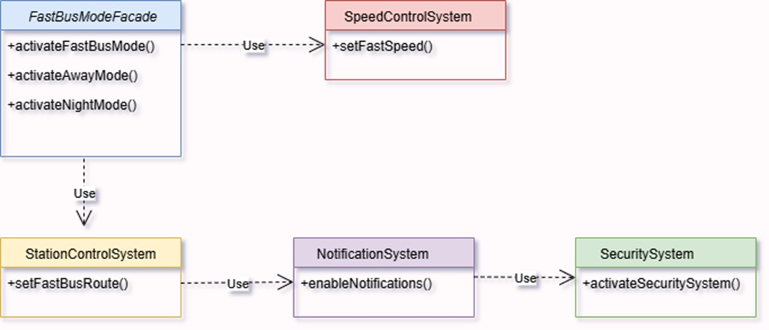

Slide 19
Test Case: Activate Fast Bus mode
Test Case ID: TC_FastBus_001
Test Case Name: Activate Fast Bus Mode
Description:
This test case ensures that when the "Fast Bus Mode" button is pressed, all the necessary subsystems (such as speed control, route selection, notifications, and security) are successfully activated, making the bus ready to operate in fa mode.
Preconditions:
  The bus should be in the default mode (not in fast bus mode).
  All subsystems (Speed Control, Station Control, Notification System, and Security System) should be operational and ready.
  The app should be open on the device.

Slide 20
6. Expected Results:
· When the "Fast Bus Mode" button is pressed, the following should occur:
Speed Control System: The bus speed is set to fast.
Station Control System: The bus route is updated to the fast bus route.
Notification System: Notifications about the bus's status (delays or route changes) are activated for passengers.
Security System: Cameras and alarms related to the bus are activated.
Steps to Execute:
  Open the bus control app.
  Ensure the bus is in the default mode (fast bus mode is not activated).
  Press the "Fast Bus Mode" button in the app's user interface.
  Observe the system's response:
    Speed Control System should adjust the bus speed to the fast speed.
    Station Control System should update the route for the bus to be in fast bus mode.
    Notification System should activate notifications to alert passengers about bus status.
    Security System should activate cameras and alarms related to the bus.

Slide 21
THANKS FOR YOUR LISTENING

